Slide 1
Diabetic retinopathy detection using deep learning to predict disease severity

Slide 2
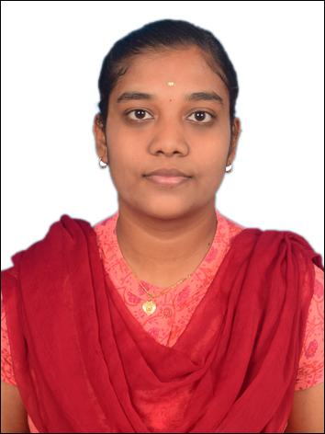

TEAM MEMBERS
AVANI(CB.SC.P2AIE24027)
JAYASRI M (CB.SC.P2AIE240O6)

Slide 3
Introduction
Diabetic Retinopathy (DR) is a serious complication of diabetes that can lead to vision loss if left untreated.
Early detection and timely intervention are crucial for preventing severe outcomes. Advances in deep learning, particularly Convolutional Neural Networks (CNNs), have enabled effective analysis of retinal images for predicting disease severity.
In addition to CNNs, Graph Neural Networks (GNNs) are being explored to enhance feature extraction and improve the accuracy of DR severity predictions, leveraging relationships within retinal image data.

Slide 4
Motivation
Early Detection: Helps identify Diabetic Retinopathy early to prevent vision loss.
Reduced Workload: Eases the burden on doctors by automating diagnosis.
Access in Remote Areas: Provides affordable diagnosis in underserved regions.
Improved Accuracy: Uses advanced models like CNNs and GNNs for precise results.
Better Healthcare Insights: Analyzes data to improve understanding and management of DR.

Slide 5
Analytical Questions
Easy:
What is the distribution of DR severity levels in the dataset?
How many images are correctly classified by the model?
2)Medium:
What are key features the model uses to predict DR severity?
How does the model perform across different severity levels?
3)Hard:
Can the model explain why certain cases are misclassified?
How robust is the model to variations in image quality or noise?

Slide 6
Predictive Questions
1)Easy:
Can the model predict whether DR is present in an image?
What is the likelihood of a severe DR case based on the input image?
2)Medium:
How accurate are the model's predictions for borderline cases?
How does the model handle unseen data during prediction?
3)Hard:
Can the model predict DR progression?
How reliable are predictions when testing on cross-domain datasets?

Slide 7
Explainability Questions
1)Easy:
Which regions of the retinal image influence the model's predictions?
What visualizations can be used to understand the model's output?
2)Medium:
Can heatmaps or saliency maps highlight important image regions for predictions?
How does the model's feature importance align with medical knowledge?
3)Hard:
How can the model’s decisions be validated or justified for clinical use?
Can counterfactual examples help explain the model's behavior?

Slide 8
Problem Statement
Diabetic Retinopathy (DR) is a leading cause of vision loss, requiring early detection for effective treatment. Current manual diagnostic methods are time-consuming and prone to errors.
The goal is to develop an automated system using deep learning (CNNs and GNNs) to accurately detect and classify DR severity, ensuring efficient and reliable diagnosis.

Slide 9
DATASET DETAILS
The images consist of gaussian filtered retina scan images to detect diabetic retinopathy. These images are resized into 224x224 pixels so that they can be readily used with many pre-trained deep learning models.All of the images are already saved into their respective folders according to the severity/stage of diabetic retinopathy using the train.csv file provided. You will find five directories with the respective images:
0 - No_DR
1 - Mild
2 - Moderate
3 - Severe
4 - Proliferate_DR

Slide 10
About The Application
Diabetic Retinopathy (DR) Detection is a deep learning-based application designed to assist in the early diagnosis and severity classification of DR. This application processes retinal images and identifies critical patterns that indicate the presence and progression of DR. By automating the detection process, it reduces the burden on medical professionals and provides reliable and timely results. The application is intended to support early intervention and improve outcomes for patients, especially in remote and underserved regions.
The application utilizes state-of-the-art machine learning techniques, including Convolutional Neural Networks (CNNs) for image feature extraction and Graph Neural Networks (GNNs) for capturing relationships within the image data. Advanced visualization techniques, such as heatmaps and saliency maps, are integrated to provide explainable outputs, enhancing its trustworthiness for clinical use.

Slide 11
Technology Details
Front End: React.js for a responsive and user-friendly interface.
Back End: Flask or Django for managing model interactions and API endpoints.
Testing Tool: PyTest for back-end logic and Selenium for UI testing.
Framework: TensorFlow 2.x or PyTorch for implementing and training the deep learning models.
Language with Version: Python 3.9+ for application development and model integration.
Server Details: Deployed on AWS EC2 with GPU support for efficient model inference.

Slide 12
LITERATURE SURVEY
Title: Diabetic Retinopathy Detection Using VGG-NIN a Deep Learning Architecture
Author: ZUBAIR KHAN1 , FIAZ GUL KHAN , AHMAD KHAN , ZIA UR REHMAN, SAJID SHAH , SEHRISH QUMMAR ,FARMAN ALI , AND SANGHEON PACK , (Senior Member, IEEE), April 14, 2021
Summary of Findings:
The VGG-NiN model combines VGG16 with Spatial Pyramid Pooling (SPP) and Network-in-Network (NiN) layers to deliver a highly efficient and accurate solution for diabetic retinopathy (DR) stage classification. This innovative architecture ensures scale invariance, enhances nonlinear feature extraction, and enables more efficient training with fewer parameters. The SPP component processes images at varying scales, allowing the model to handle multi-scale inputs effectively, while the NiN layers introduce nonlinearity for improved classification performance. Experimental results demonstrate that the VGG-NiN model significantly outperforms existing state-of-the-art methods, achieving superior classification accuracy of DR stages using colored fundus images. Moreover, the model achieves high accuracy with reduced parameters and faster training times, making it a resource-efficient and powerful tool for DR detection.

Slide 13
LITERATURE SURVEY
Title: Diabetic Retinopathy Detection and Classification Using Mixed Models for a Disease Grading Database
Author: ANAS BILAL , (Member, IEEE), GUANGMIN SUN, YU LI, SARAH MAZHAR, AND ABDUL QADIR KHAN
Summary of Findings:
Predicting the presence of microaneurysms in fundus images is crucial for the early detection of diabetic retinopathy (DR), a condition caused by prolonged high blood glucose levels that can lead to vision loss. The proposed system utilizes deep learning with convolutional neural networks (CNNs) and semantic segmentation algorithms to analyze fundus images, classify them as normal or infected, and grade them into early, moderate, or severe non-proliferative diabetic retinopathy (NPDR). Accelerated by GPU, this high-performance, low-latency system provides an automated solution to assist ophthalmologists in early DR diagnosis, improving efficiency and accuracy in medical image analysis.

Slide 14
LITERATURE SURVEY
Title: Diabetic Retinopathy Detection Using Prognosis of Microaneurysm and Early Diagnosis System for Non-Proliferative Diabetic Retinopathy Based on Deep Learning Algorithms
Author: LIFENG QIAO , YING ZHU , AND HUI ZHOU
Summary of Findings:
Diabetic retinopathy (DR), a leading cause of blindness caused by high blood sugar damaging the retina, can be prevented with early detection and diagnosis. To address this, a novel hybrid approach for DR detection and classification is proposed, combining models to enhance robustness and accuracy through a majority voting method. The system involves preprocessing to enhance abnormalities and segmentation, feature extraction to focus on relevant data, and classification using SVM, KNN, and binary trees. Using multiple graded disease databases, the method achieved 98.06% accuracy, 83.67% sensitivity, and 100% specificity, demonstrating its effectiveness in DR detection.

Slide 15
LITERATURE SURVEY
Title: Deep Learning in Automatic Diabetic Retinopathy Detection and Grading Systems: A Comprehensive Survey and Comparison of Methods
Author: ISRAA Y. ABUSHAWISH , (Member, IEEE), SUDIPTA MODAK , (Member, IEEE), ESAM ABDEL-RAHEEM , (Senior Member, IEEE), SOLIMAN A. MAHMOUD , (Senior Member, IEEE), AND ABIR JAAFAR HUSSAIN , (Senior Member, IEEE)
Summary of Findings: Diabetic retinopathy, a leading cause of vision loss globally, has driven the need for advanced automatic detection methods. This paper surveys the evolution from traditional machine learning to deep learning techniques, focusing on convolutional neural networks (CNNs). It highlights the role of transfer learning, hybrid models, and AI interpretability in addressing medical detection challenges and integrating real-time screening into clinical workflows. The study evaluates 26 pre-trained CNN models, comparing state-of-the-art architectures, and uses Grad-CAM visualization to interpret model decisions, bridging advanced AI techniques with practical healthcare applications.

Slide 16
TESTING
1. Split Ratio
Ensure that the test dataset is separate from training and validation datasets to maintain unbiased evaluation. Common split ratios:
80-10-10: Training, validation, and testing.
Alternatively, allocate a sufficient number of samples for robust testing.
2. Hyperparameter Validation
Evaluate if the model's hyperparameters (e.g., learning rate, batch size) are consistent with the optimized ones during training.
Avoid hyperparameter tuning on the test dataset to prevent overfitting.
3. Device Used
Choose the appropriate hardware for testing:
GPU: For faster inference on deep learning models.
CPU: For lightweight evaluation or deployment simulations.
Document the hardware used to report inference time.

Slide 17
TESTING
4. Evaluation Metrics
Calculate performance metrics for diabetic retinopathy severity classification:
Accuracy: Overall correctness of the model.
Confusion Matrix: To analyze true positives, false positives, etc.
Precision, Recall, F1-Score: To handle imbalanced classes.
ROC-AUC Curve: To evaluate the model’s ability to distinguish between severity levels.
5. Data Generation
Assess the impact of augmentations applied during training/testing.
Test on:
Original Images: Direct predictions without augmentation.
Augmented Test Set: To evaluate model robustness against transformations (e.g., brightness, rotations).
6. Training/Testing/Validation Matching
Ensure preprocessing steps like resizing, normalization, or feature scaling are identical between training, validation, and testing phases.
This ensures that the test results are consistent and reliable.
7. Early Stopping Metrics
Compare test performance against the last saved model checkpoint to verify:
That the model hasn’t overfit on the training data.
Whether early stopping was effective in improving generalization.

Slide 18
ALGORITHM EXPLANATION AND HYPERPARAMETERS
Dataset: The dataset consists of retinal images labeled with corresponding DR stages. The dataset is split into training, validation, and test sets.
Preprocessing:
Images are resized to 224x224 pixels.
Normalization is applied by rescaling pixel values to the range [0, 1].

Slide 19
ALGORITHM EXPLANATION AND HYPERPARAMETERS..
CNN Model:
Architecture:
Convolutional layers extract spatial features from fundus images(microaneurysms,hemorrhages).
Pooling layers reduce dimensionality and computation.
Fully connected layers classify the images into different severity levels.
Hyperparameters:
Optimizer: Adam
Learning Rate: 0.001
Batch Size: 32
Loss Function: Categorical Cross Entropy
Activation Functions: ReLU for hidden layers, Softmax for output

Slide 20
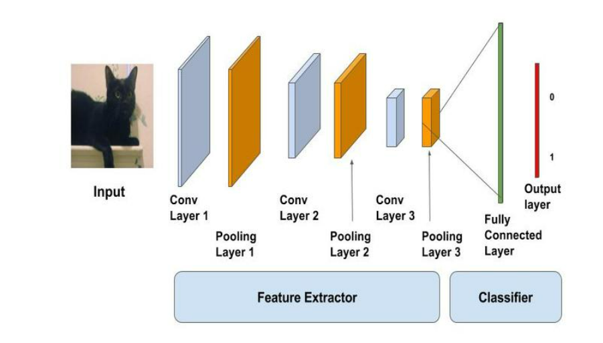
ALGORITHM EXPLANATION AND HYPERPARAMETERS..

Slide 21
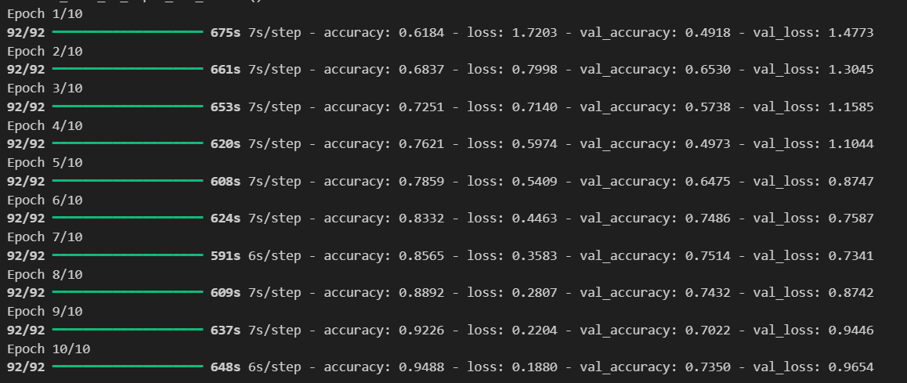
ALGORITHM EXPLANATION AND HYPERPARAMETERS..

Slide 22
ALGORITHM EXPLANATION AND HYPERPARAMETERS..
GRU Model:
Architecture:
GRU is employed to analyze sequential dependencies in the extracted features, making it useful for identifying temporal patterns. Since CNNs extract spatial features, GRUs complement this by capturing dependencies between extracted features across different spatial locations.
Hyperparameters:
Optimizer: Adam
Learning Rate: 0.0005
Number of GRU units: 64
Batch Size: 32
Loss Function: Categorical Cross Entropy

Slide 23
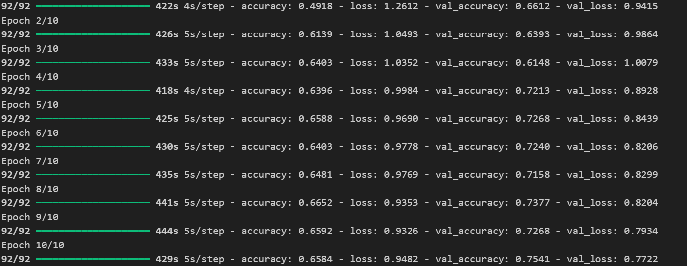
ALGORITHM EXPLANATION AND HYPERPARAMETERS..

Slide 24
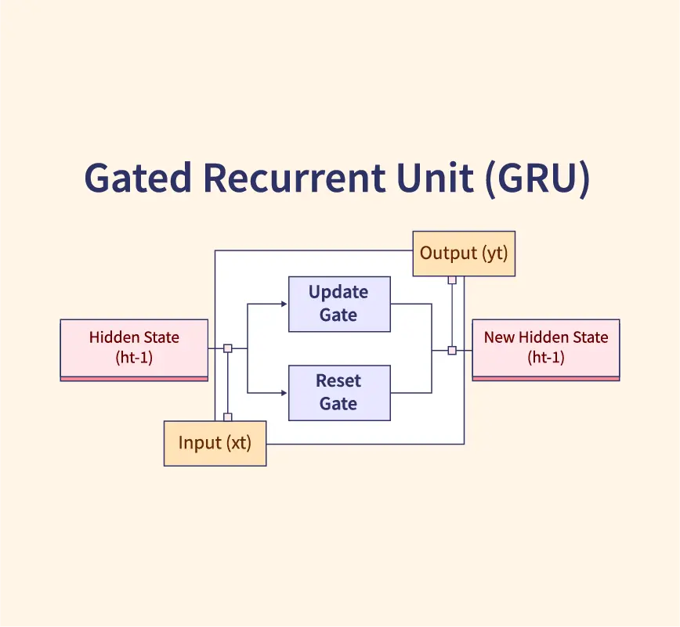
ALGORITHM EXPLANATION AND HYPERPARAMETERS..

Slide 25
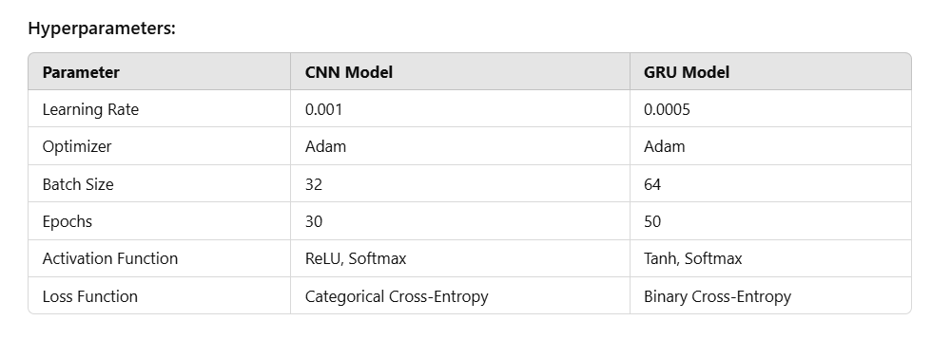
ALGORITHM EXPLANATION AND HYPERPARAMETERS..

Slide 26
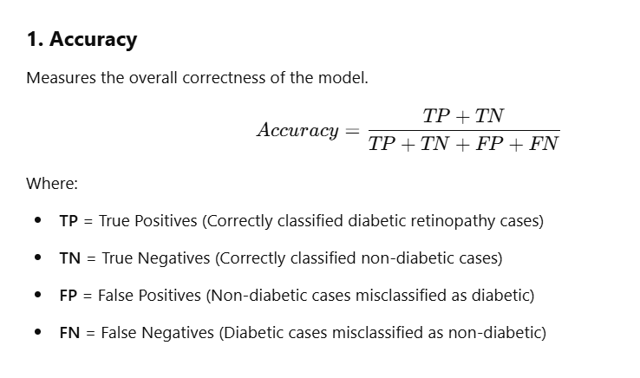
PERFORMANCE METRICS

Slide 27
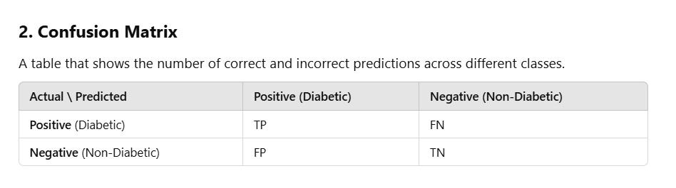
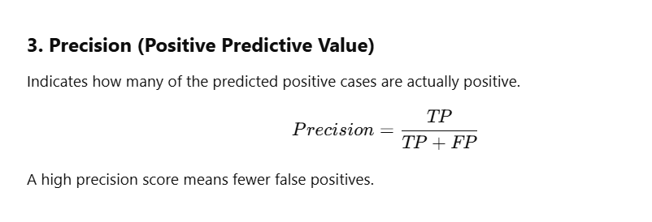

Slide 28
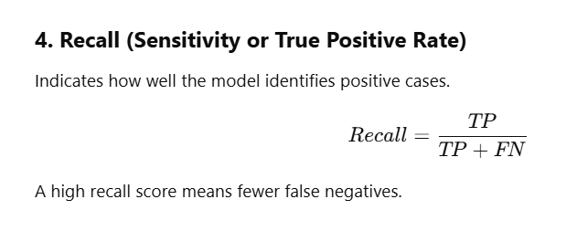
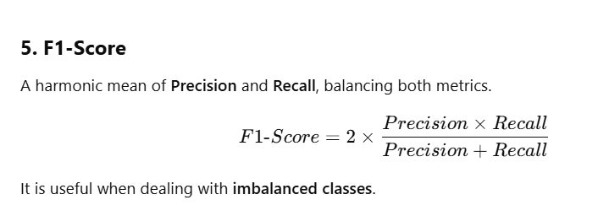

Slide 29
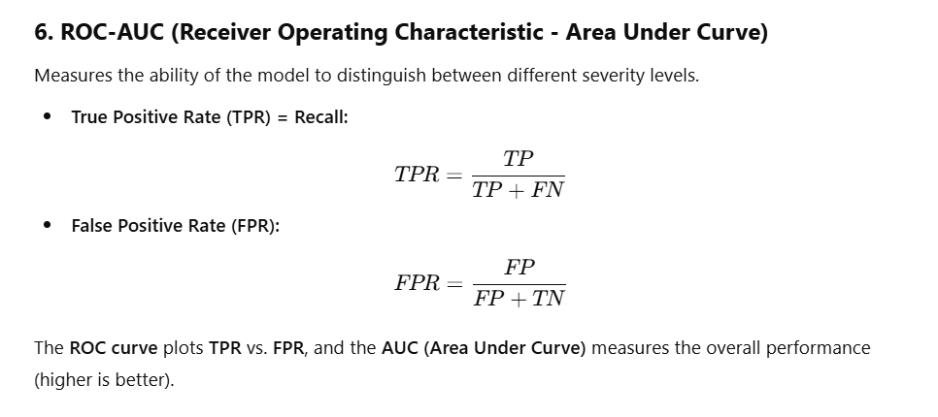

Slide 30
UI DESIGN
Screens in the Application
Home Screen: Overview of diabetic retinopathy detection.
Image Upload: Upload retinal images for diagnosis.
Diagnosis Result: Model prediction output with confidence scores.
Patient History: Store and view past diagnoses.
Doctor’s Recommendation: Suggest treatment based on severity.
The wireframe should include simple layouts with buttons for image upload and displaying classification results.

Slide 31
MODULE DIAGRAM
Dataset Preprocessing Module:
Loads images, normalizes them, and splits into training, validation, and test sets.
Feature Extraction Module:
CNN extracts spatial features.
GRU captures temporal patterns.
Classification Module:
The model classifies images into No DR, Mild, Moderate, Severe, or Proliferative DR.
Deployment Module:
Implements the trained model in a web-based UI or application.

Slide 32
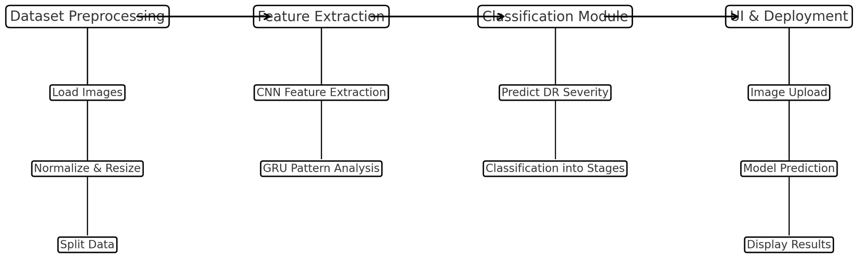
MODULE DIAGRAM..

Slide 33
References
1.Diabetic Retinopathy Detection Using VGG-NIN a Deep Learning Architecture ,April 10, 2020, ZUBAIR KHAN1 , FIAZ GUL KHAN , AHMAD KHAN , ZIA UR REHMAN, SAJID SHAH , SEHRISH QUMMAR ,FARMAN ALI , AND SANGHEON PACK , (Senior Member, IEEE), April 14, 2021
2. Diabetic Retinopathy Detection Using Prognosis of Microaneurysm and Early Diagnosis System for Non-Proliferative Diabetic Retinopathy Based on Deep Learning Algorithms ,May 11, 2020 , LIFENG QIAO , YING ZHU , AND HUI ZHOU .
3. Diabetic Retinopathy Detection Using Prognosis of Microaneurysm and Early Diagnosis System for Non-Proliferative Diabetic Retinopathy Based on Deep Learning Algorithms ,May 2, 2020, LIFENG QIAO , YING ZHU , AND HUI ZHOU .
4. Deep Learning in Automatic Diabetic Retinopathy Detection and Grading Systems: A Comprehensive Survey and Comparison of Methods 7 ,June 2024, ISRAA Y. ABUSHAWISH , (Member, IEEE), SUDIPTA MODAK , (Member, IEEE), ESAM ABDEL-RAHEEM , (Senior Member, IEEE), SOLIMAN A. MAHMOUD , (Senior Member, IEEE), AND ABIR JAAFAR HUSSAIN , (Senior Member, IEEE)

